Slide 1


Prototype for Medical Sensor over BLE
DNA Space + WiFi + Application
Notes:
Welcome to the Customer Experience training series.

Slide 2
Team members
Team Name: Great Eagle
Rich Yim | Cisco Systems
Ray Leung | Cisco Systems
Ian Wong | Vega Technoloigy

Slide 3
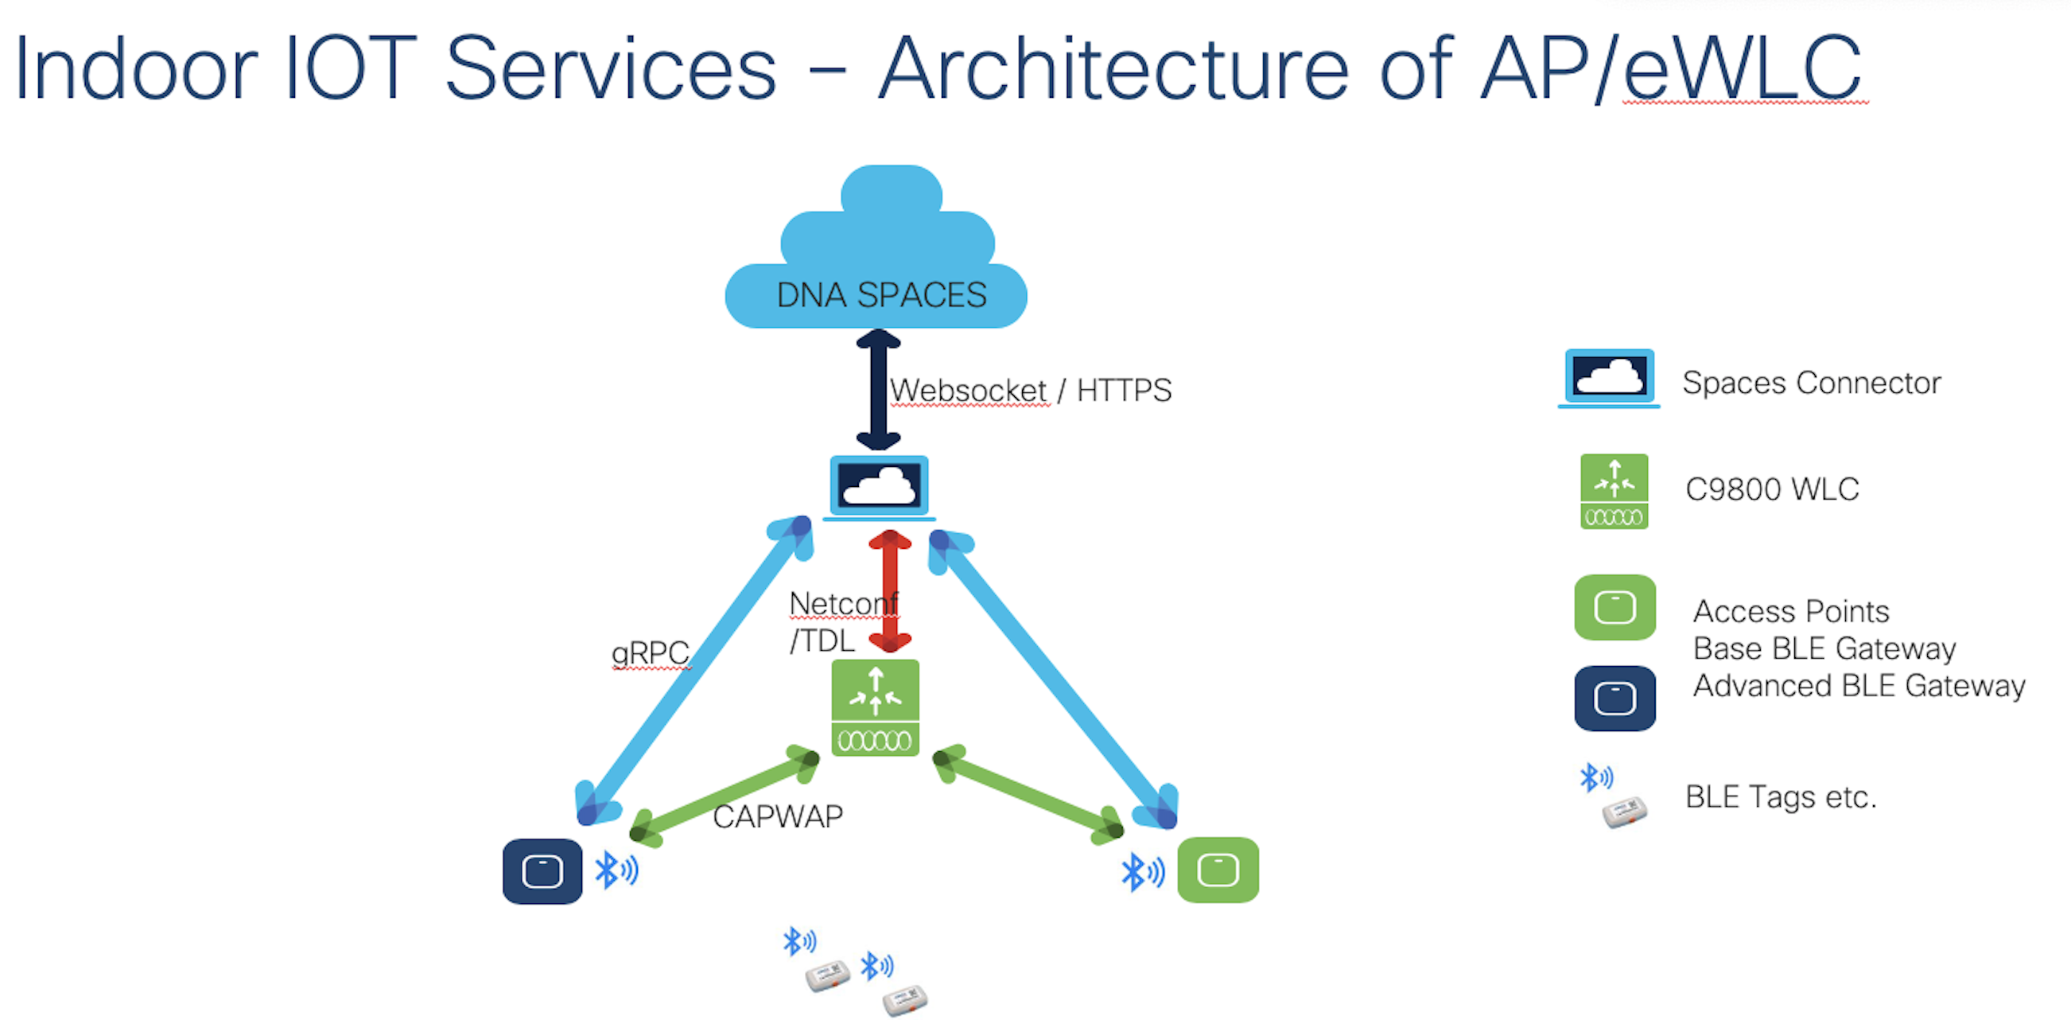

Slide 4


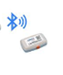
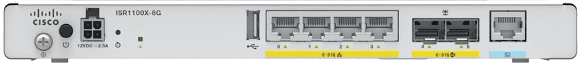
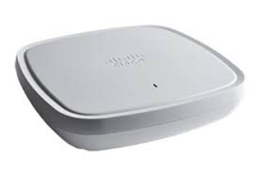
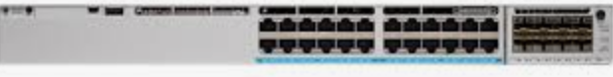
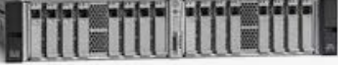



Test Bed Physical Architecture
Cisco ISR1100
Internet Router
Internet
OOB Switch
Cisco UCS
Catalyst 9800
App Server
ASA5506 + Anyconnect

Slide 5




Test Bed Application Architecture
RESTFul
Database Server
App Server
DNA Space

Slide 6
High Level Design
Expected
Outcome
The BLE sensor can generate real time data and stream to DNA Space
Upon telemetry threshold, the DNA Spaces will trigger a RESTful call to a save the the incident to MySQL Database and it can also trigger SMS Gateway.
Key solutions & Methodologies
MySQL as backend database
Python script to trigger telnet to Cisco IR809 and execute CLI for sending SMS
PHP for RESTFul API development

Slide 7
DNA Spaces Setup

Slide 8
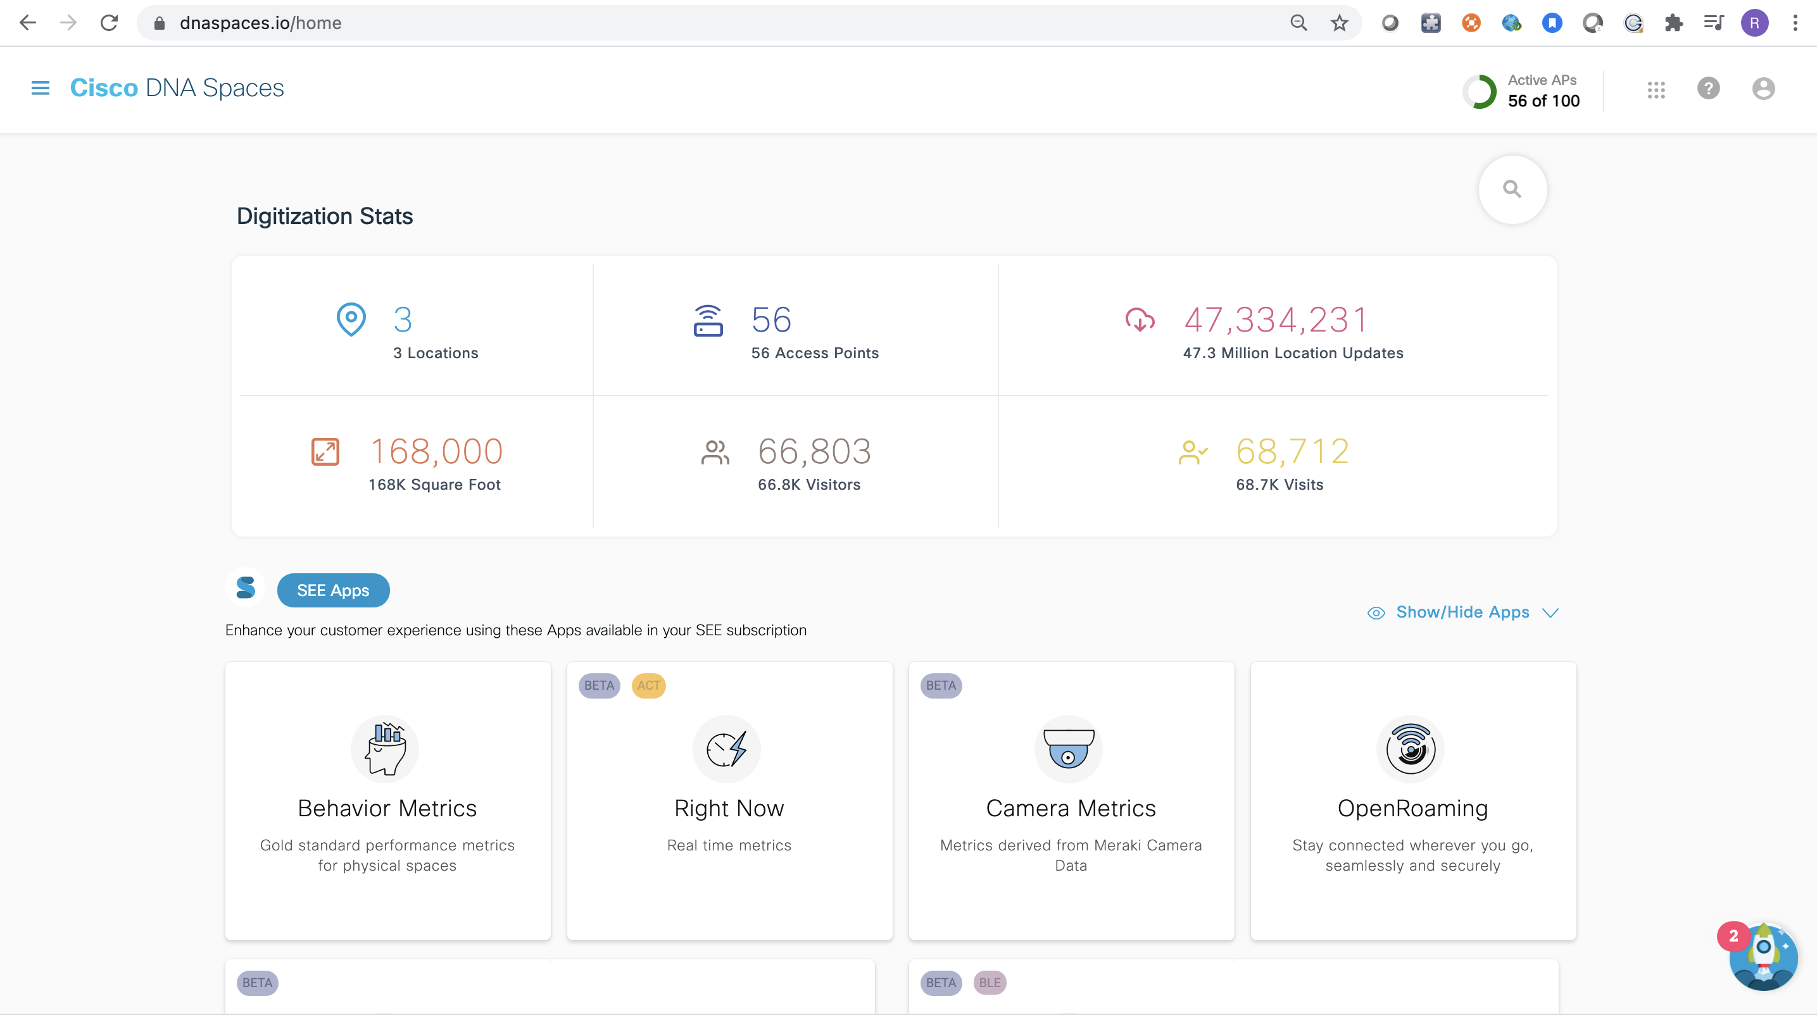
Step 1. Login DNA Space

Slide 9
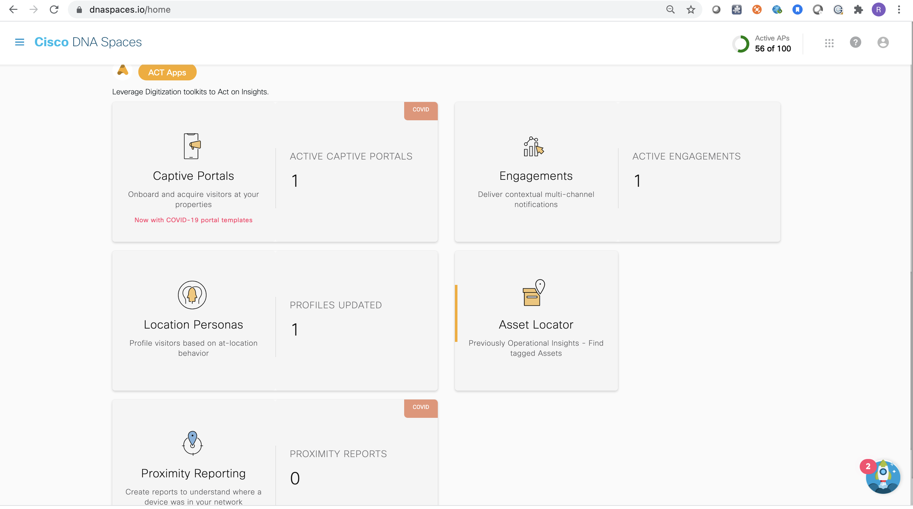
Step 2. Click Assess Locator

Slide 10
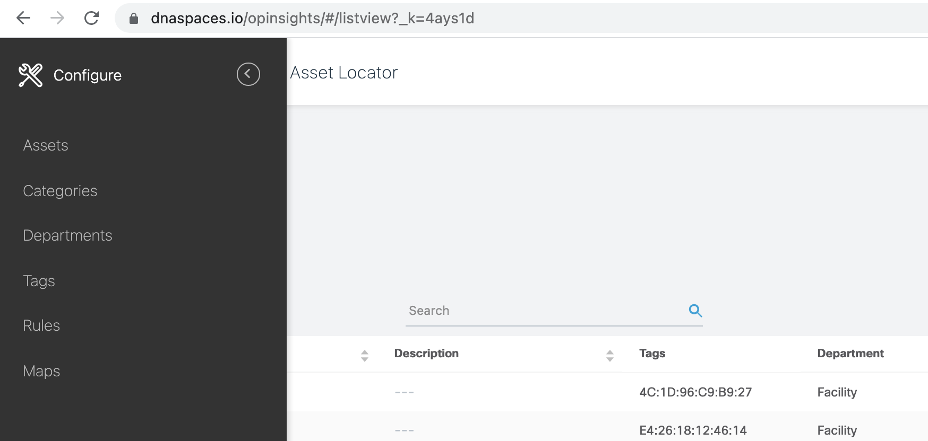
Step 3. Setup Rule

Slide 11
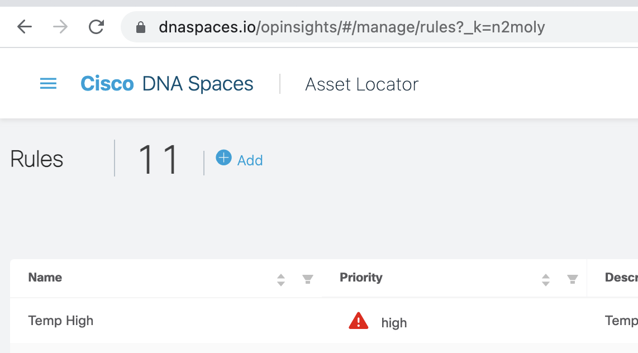
Step 4. Click to add a new rule

Slide 12
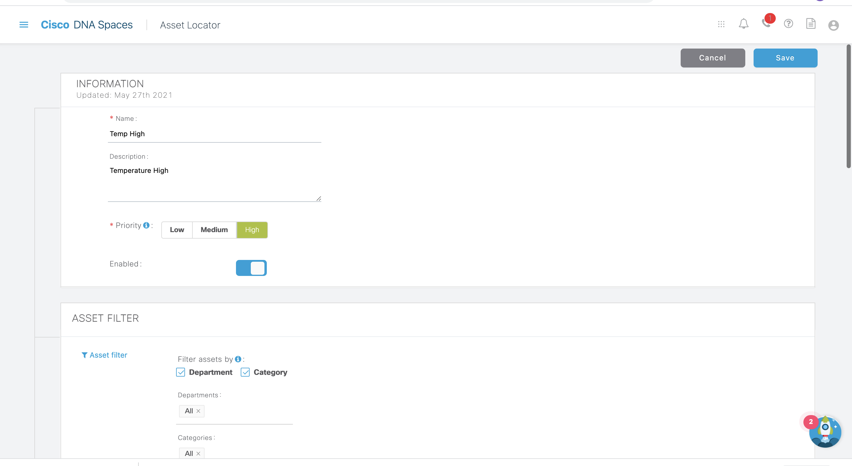
Step 5. Fill in the name and description

Slide 13
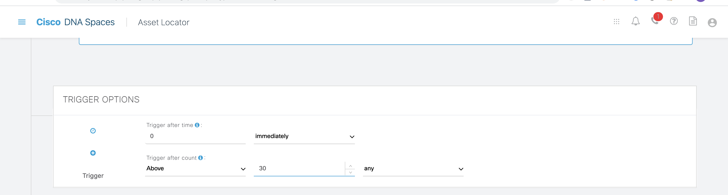
Step 6. Setup trigger (30 deg C)
o

Slide 14
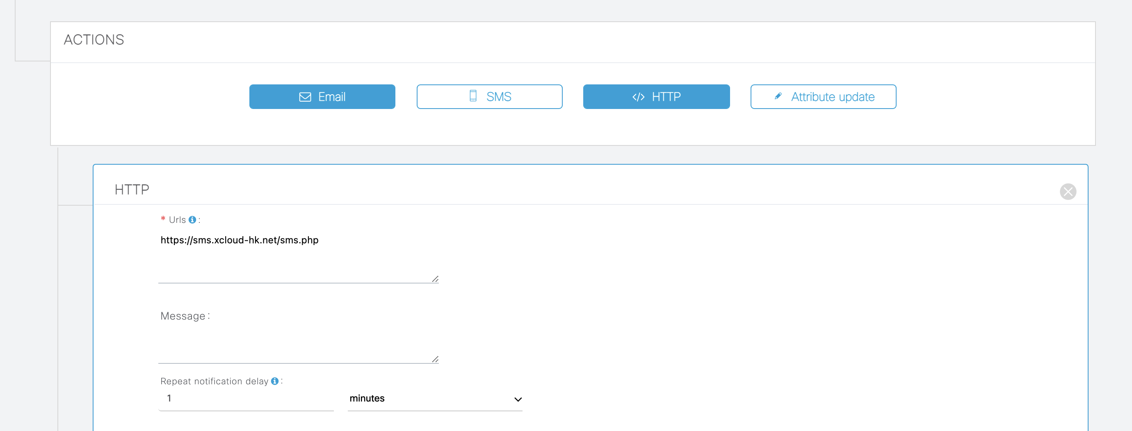
Step 7. Select “http” as RESTFul call
For http RESTFul call, we have to setup a FQDN.
I have use AWS Route 53 for the Domain name setup
Shortest delay is 1 minutes for immediate trigger

Slide 15
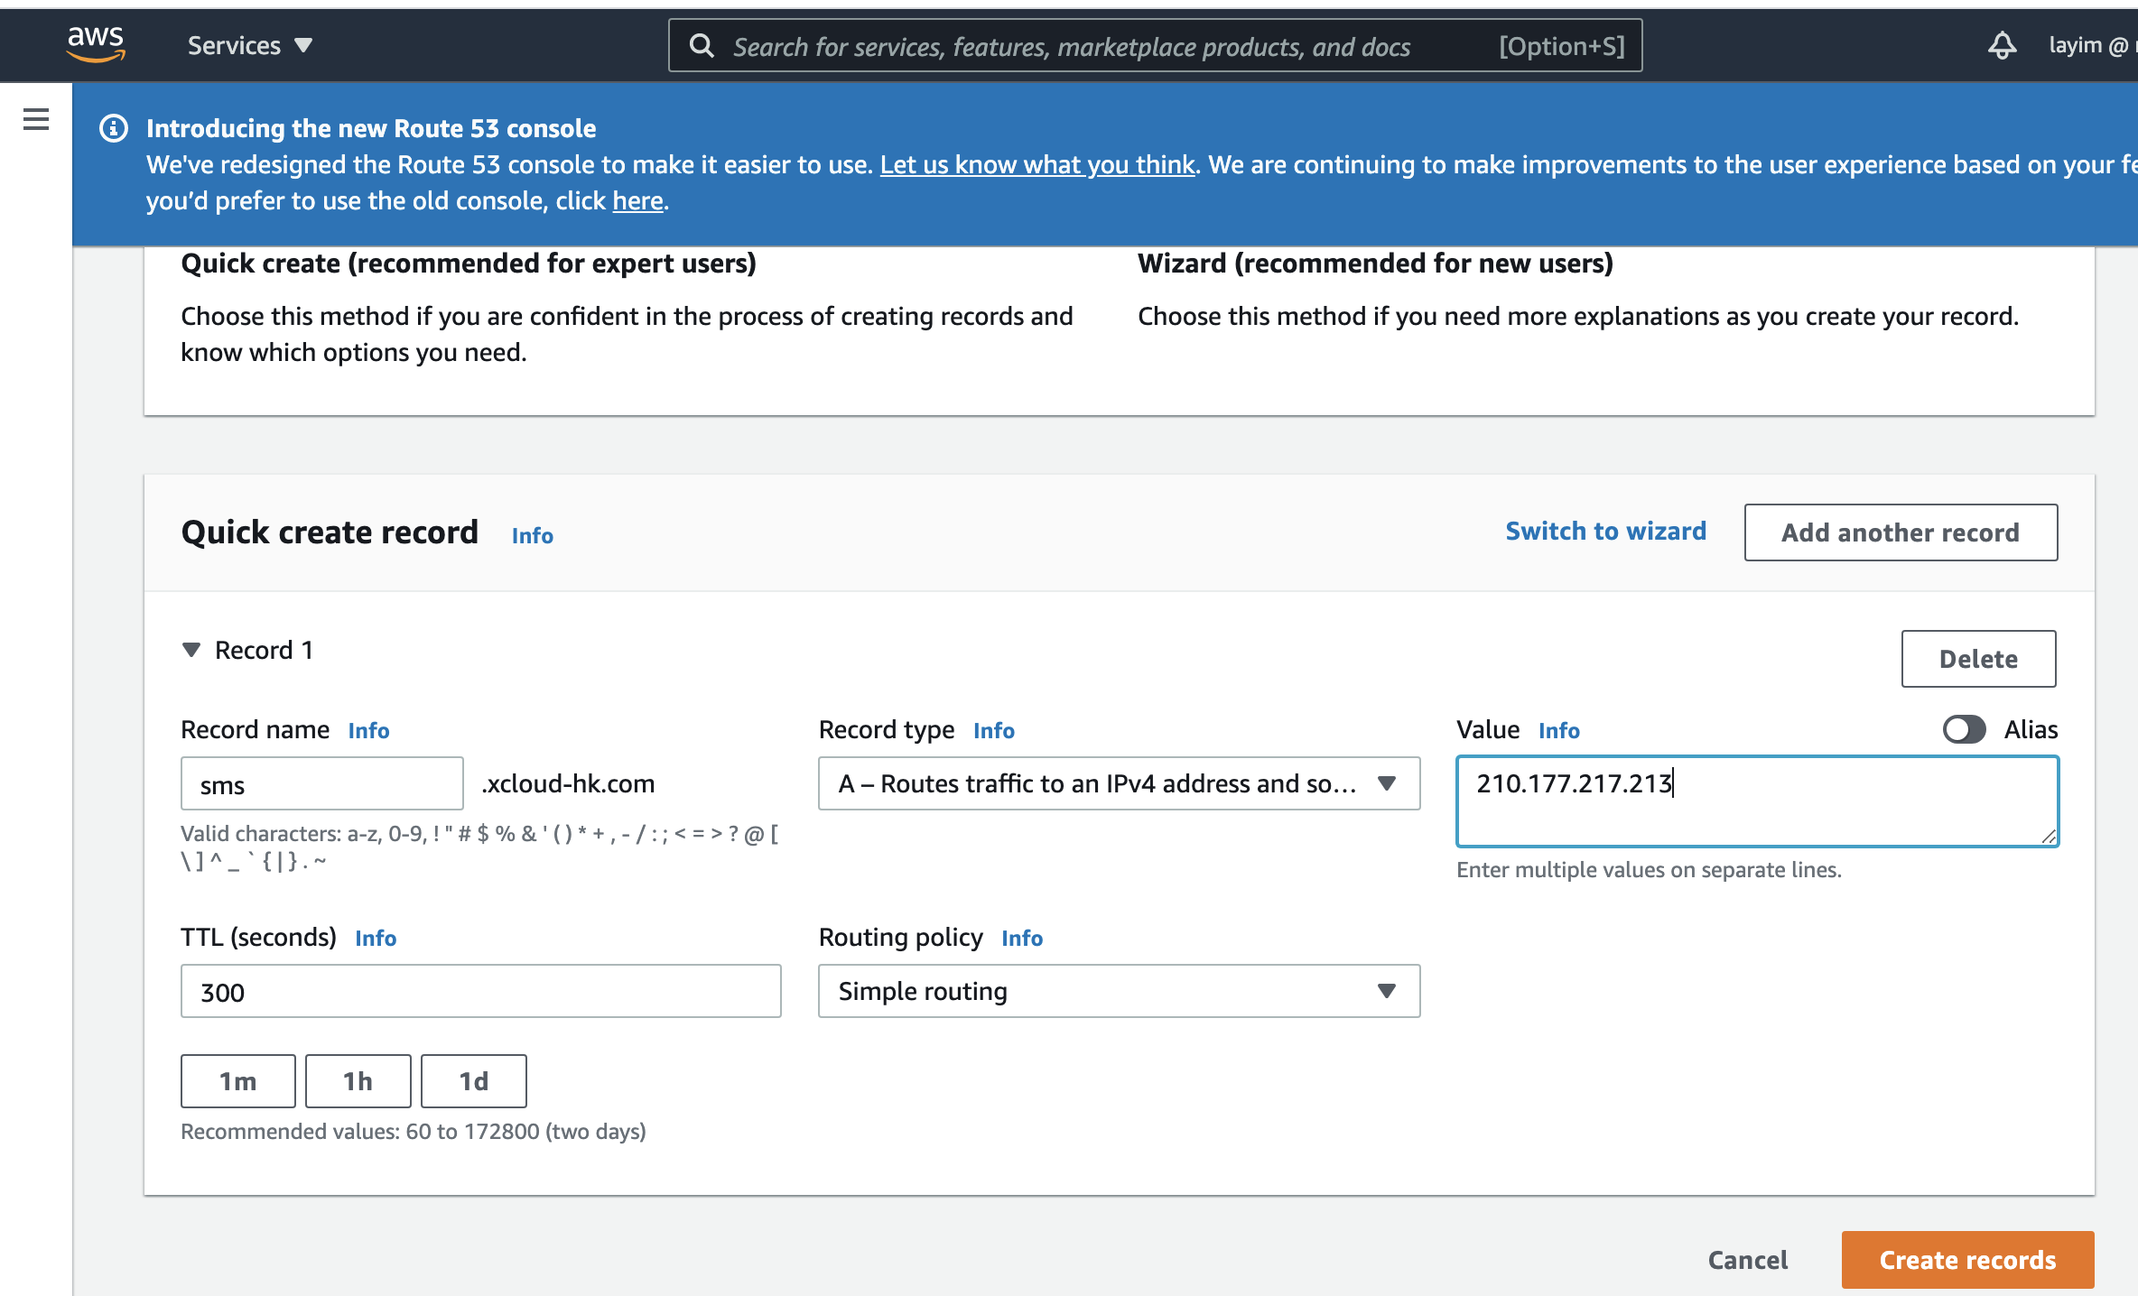
Step 8. Setup the FQDN in the AWS Route 53
Notes:
So, what’s changing?
Our Customer Experience vision takes our services portfolio to the next level with a new and simplified approach. Our new services offerings are designed to make your customer’s transformation journey simpler, more agile, and more innovative.

Slide 16
App Server Software Setup

Slide 17
PHP Script to accept RESTFul call from DNA Space
<?php
$dbms='mysql';
$host='10.80.9.1';
$dbName='exampledb';
$user='remote';
$pass='C1sc0123'
$dsn="$dbms:host=$host;dbname=$dbName";
try {
$dbh = new PDO($dsn, $user, $pass);
echo "Connected to Database<br/>";
/* Can do more here */
foreach ($dbh->query('SELECT * from example') as $row) {
echo $row[0] "<br>" ;
}
$dbh->query('insert into example (first, second) values ("DNA Space", "Trigger")');
$dbh = null;
} catch (PDOException $e) {
die ("Error!: " . $e->getMessage() . "<br/>");
}
?>

Slide 18
SMS Gateway Setup
File: SMS.txt
admin
C1sc0123
enable
cellular 0 lte sms send 96422596 DNA Space Trigger
File: sendSMS.sh
#!/bin/bash
curl telnet://10.80.5.242 < SMS.txt

Slide 19
Application Demo

Slide 20
Sending SMS by DNA Space

